Slide 1
302 Group Presentation
Manufacturer
Team member:
Lau Dzi King (54777467)
Wan Ho Yin (54777500)
Lau Ka Ho (54777420)
Lam Pak Fung (54777676)

Slide 2
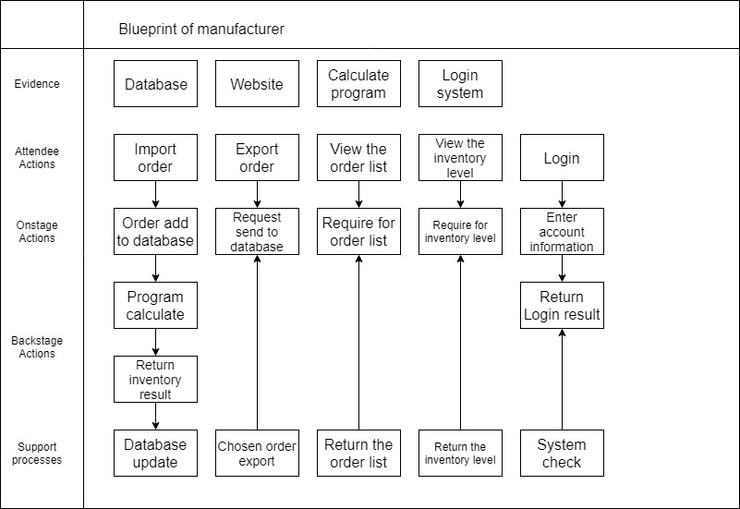
Service blueprint

Slide 3
Agile Project Charter
Project Name | Project Dragonfly
Project Champion | Edmond Lau
Project Sponsor | Frankie Lau
Project Manager | Wan Ho Yin
Stakeholders | Winco Lam

Slide 4
Project Details
Mission | The goal of this project is to create a system that can import the order from online retailer, save the order and inventory level into the database
Scope | Order in the online retailer, check the inventory, and finally hand it to the logistics department
Success Metrics | Data import and Export from database successful, inventory program operation successful

Slide 5
Project Plan
Task Name | Responsible | Start | End | Days | Status
Sprint 1 | Yin, Edmond | 2/22 | 3/8 | 6 | Complete
Create database | Yin, Edmond | 2/22 | 2/23 | 2 | Complete
Task database | Yin | 3/1 | 3/2 | 2 | Complete
Database debug | Frankie | 3/7 | 3/8 | 2 | Complete

Slide 6
Project Plan
Task Name | Responsible | Start | End | Days | Status
Sprint 2 | Yin | 2/22 | 3/29 | 35 | Complete
Program design | Frankie, Yin, Edmond, Winco | 2/22 | 2/28 | 6 | Complete
Write program | Frankie | 3/1 | 3/3 | 2 | Complete
Program debug | Yin, Edmond, Winco | 3/5 | 3/8 | e | Complete

Slide 7
User Story
As a | I want to | So that I can
Employee Clerk | have a database | save the order and inventory level to the database
Employee Clerk | import and export the order to database | import the database from online retailer
Employee Clerk | review the entered order and the inventory level | check if the inventory level is not enough
Employee Clerk | review the order | check if there are orders still processing
Employee Clerk | have a calculation program | let the program calculated the remain inventories

Slide 8
Product Backlog
Task Name | Story | Sprint Ready | Priority | Status | Assigned to Sprint
Sprint 1 | Yes | Yes | High | Completed | Yes
Create database | Yes | Yes | Medium | Completed | Yes
Test database | Yes | Yes | Low | Completed | Yes
Database debug | No | Yes | Medium | Completed | Yes
Sprint 2 | Yes | Yes | High | Completed | Yes
Program design | Yes | Yes | Medium | Completed | Yes
Write program | Yes | Yes | High | Completed | Yes
Program debug | No | No | High | Completed | No

Slide 9
Sprint Backlog
Backlog Item | Story Points | Responsible | Status
User Story#1 | 6
Create database | 2 | Yin, Edmond | Completed
Import/export data from database | 2 | Winco | Completed
View the order | 2 | Frankie | Completed
User Story#2 | 6
Design program | 1 | Frankie, Yin, Edmond, Winco | Completed
Wrtie program | 3 | Frankie | Completed
Program debug | 2 | Yin, Edmond, Winco | Completed

Slide 10
Github link
https://github.com/Edmond12321/302

